Slide 1
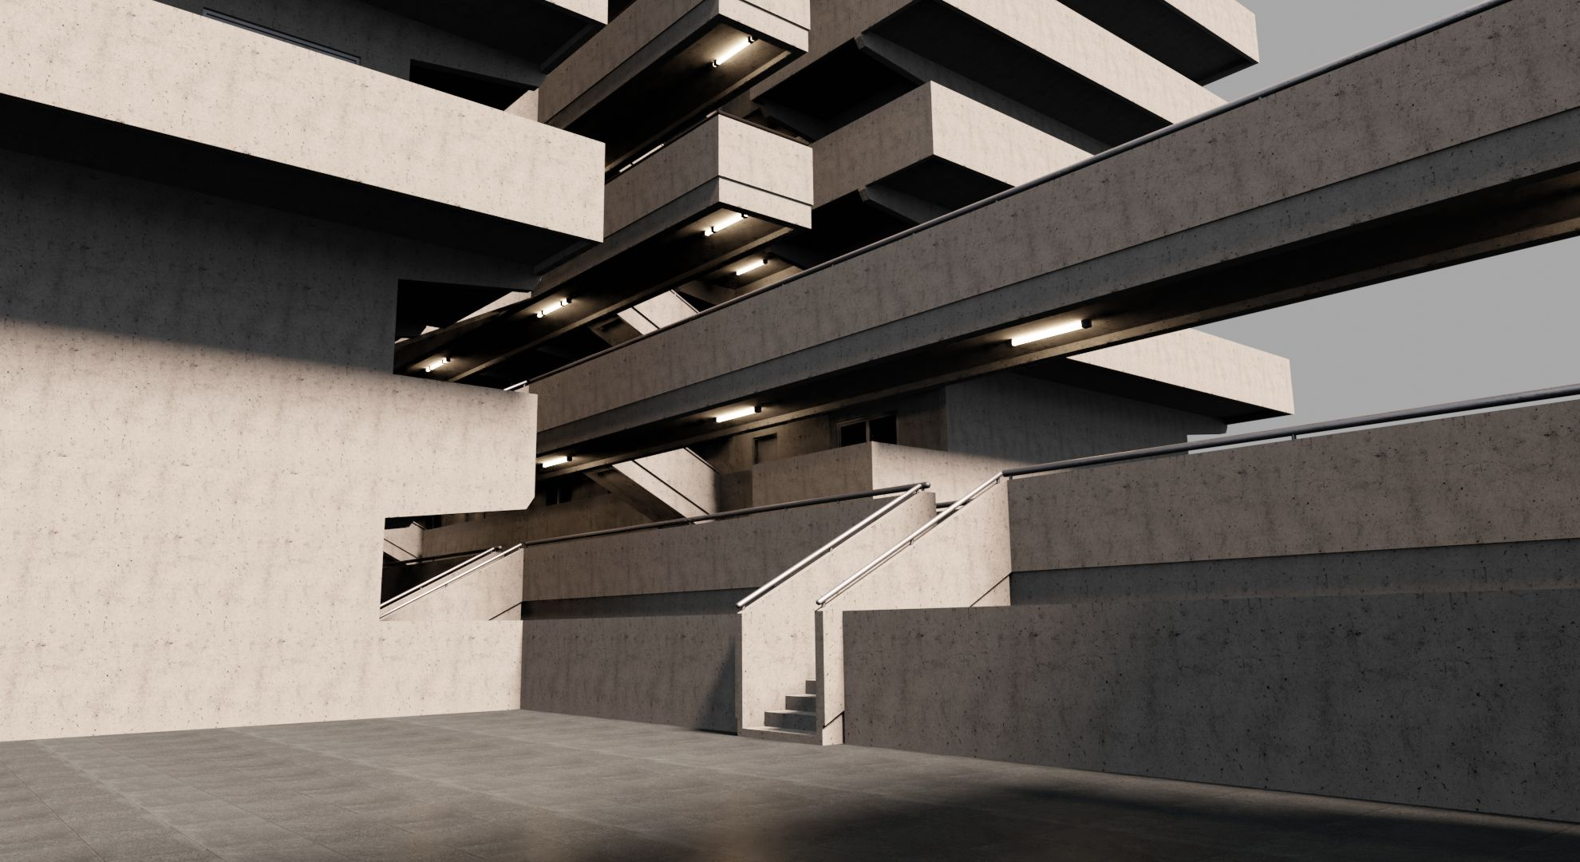
Fiber in Concrete
When does it succeed?
A Group Project by Miguel Meier, Laurent Le Febve Vivy, Marc Popp and Nathalia Pantaleoni

Slide 2
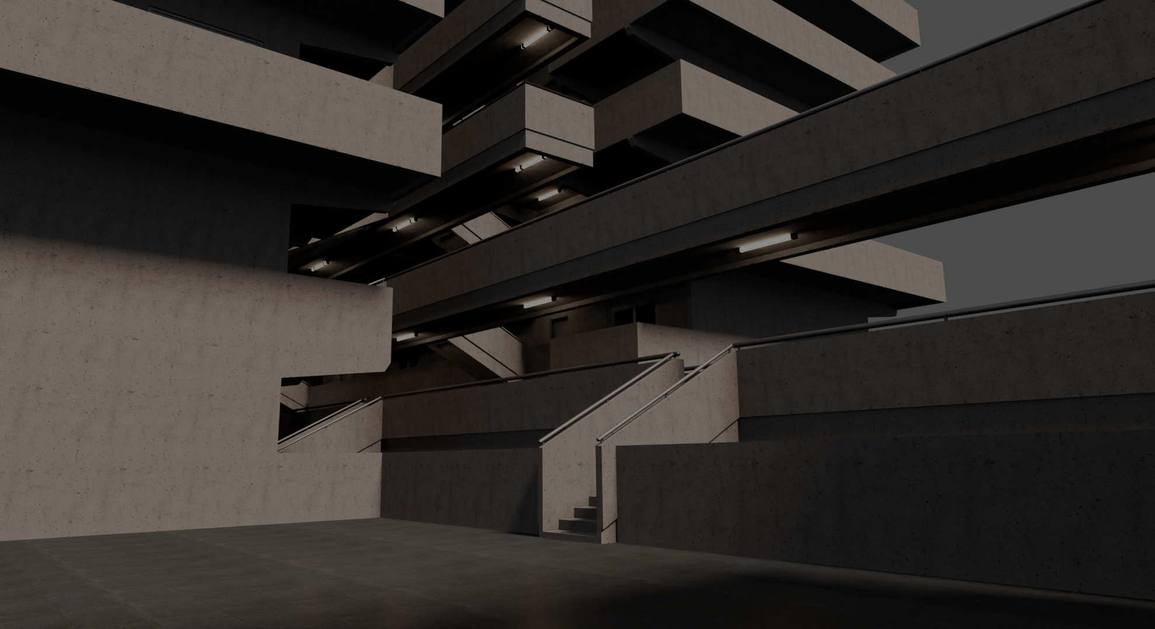
Our Motivation
Concrete is crucial for our society's infrastructure
Fiber-Reinforcement to strengthen durability
When does it succeed?
Our aim: be involved in real data scientists' problems

Slide 3
The Data
Sourced from a series of experimental trials by the SIKA R&D-department
1440 observations and 10 variables:
Titer [tex]
average circumference [mm]R
fiber length [mm]
fiber tenacity [mm]
surface waviness parameters W_sm and W_q [µm]
expected concrete compression strength 95% rH [mPa]
interfacial shear stress (IFSS)
Minibeam energy absorption [J]
fiber failure mode in beam (0 = success, 1 = failure)

Slide 4
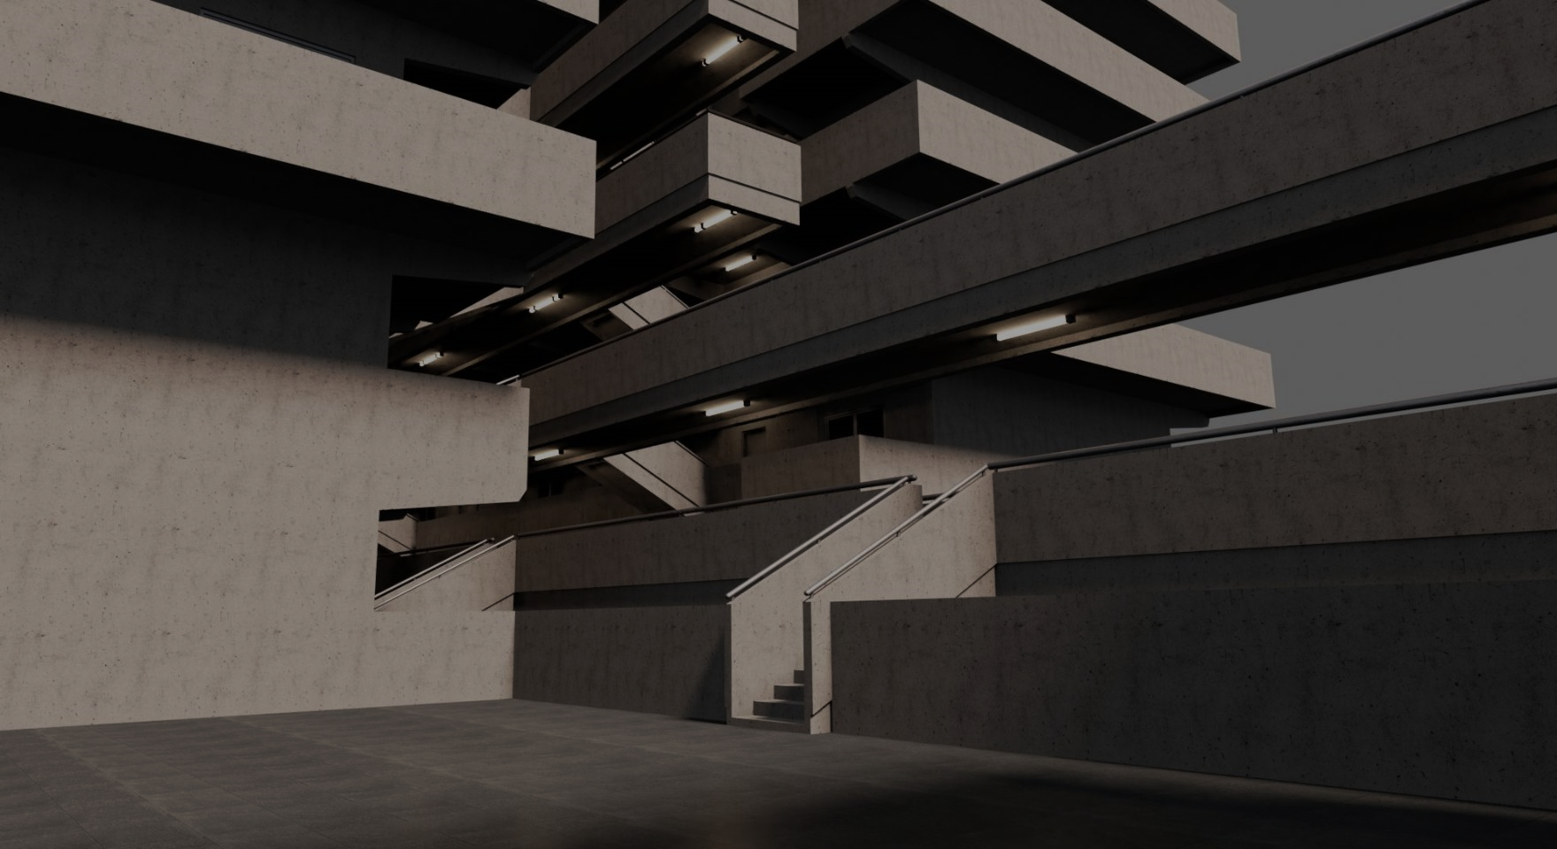
The Goal - 3 Level Predictive Modeling
1. Level Hypothesis: IFSS
Interfacial sheer strength (IFSS) can be sufficiently predicted through the profile area, fibre length, avg. fibre circumference and Titer.
2. Level Hypothesis: Minibeam energy absorption
IFSS and fibre tenacity can be used to sufficiently predict Minibeam energy absorption and subsequently failure.
3. Level Hypothesis: IFSS
Failure Mode can be predicted from minibeam energy absorption.

Slide 5
The Goal – Flowchart 3 Level Predictive Modeling
1. Level
2. Level
3. Level
W_Sm
calculate
Profile Area
W_q
Fibre length
predict
IFSS
Titer
predict
Minibeam energy absorption
predict
Failure mode
Fibre Tenacity
Avg. circumference

Slide 6
The Catch
In the Field, it is common that not all parameters are known
To be applicable to the real-world, this issue has to be dealt with
Prediction of missing parameters is often not possible
Solution:
Create multiple models and figure out which works best for which missing data
Incorporate a decision-tree approach were the most reliable model is chosen for the situation

Slide 7
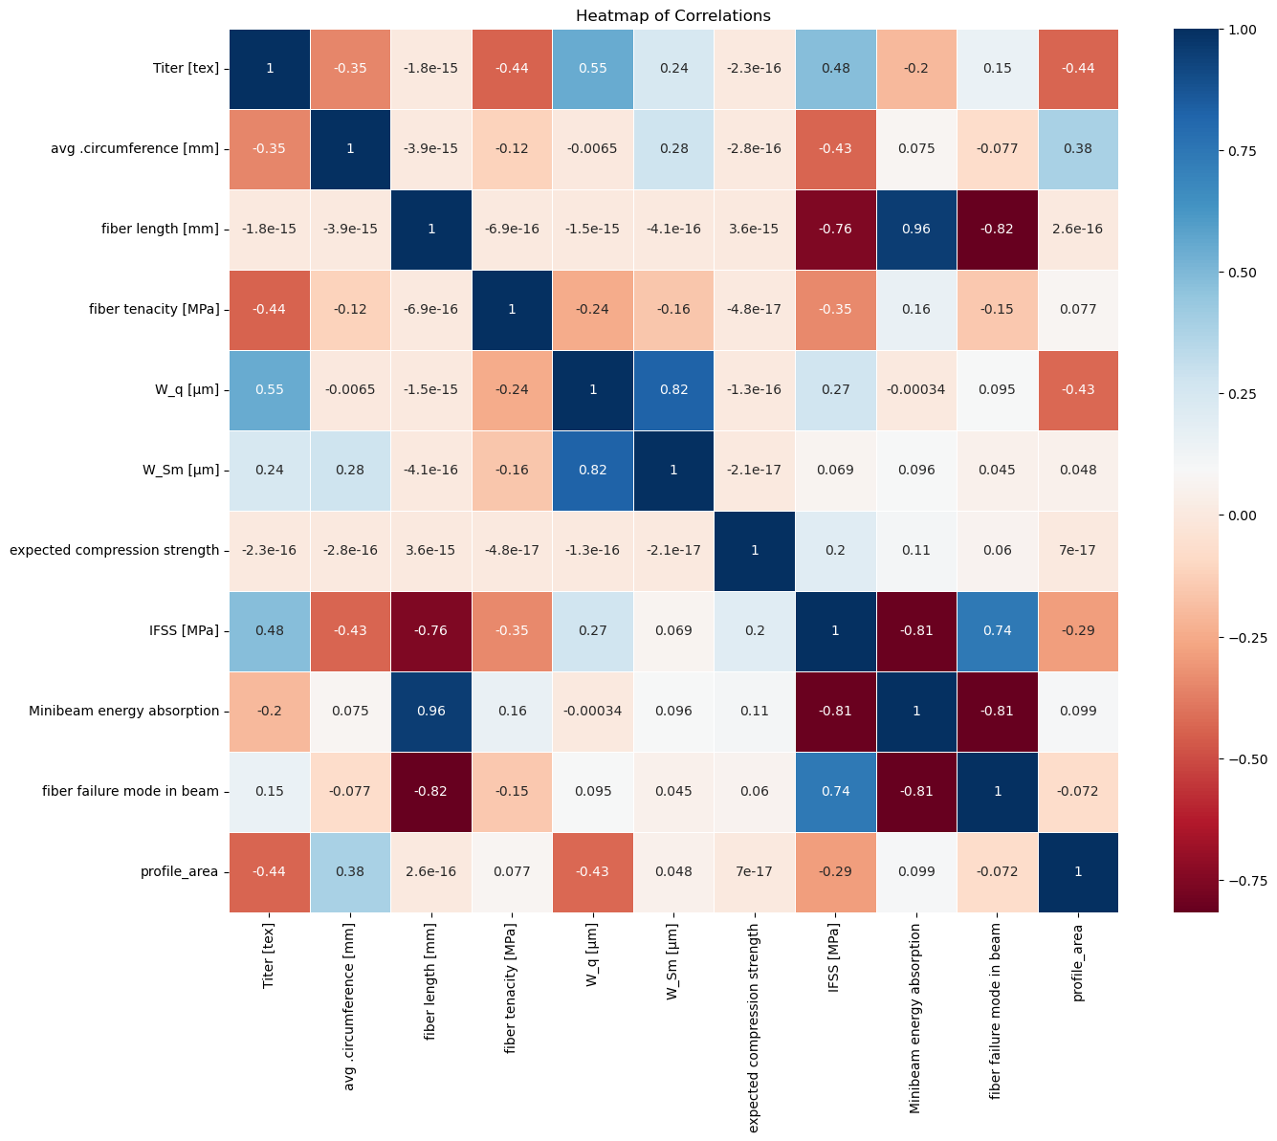
The EDA
No significant outliers found with z-scores > 3 or <-3
Some significant correlations found through PearsonsR
Some unexpected correlations with fibre length
Not a perfect correlation between failure mode and energy absorption

Slide 8
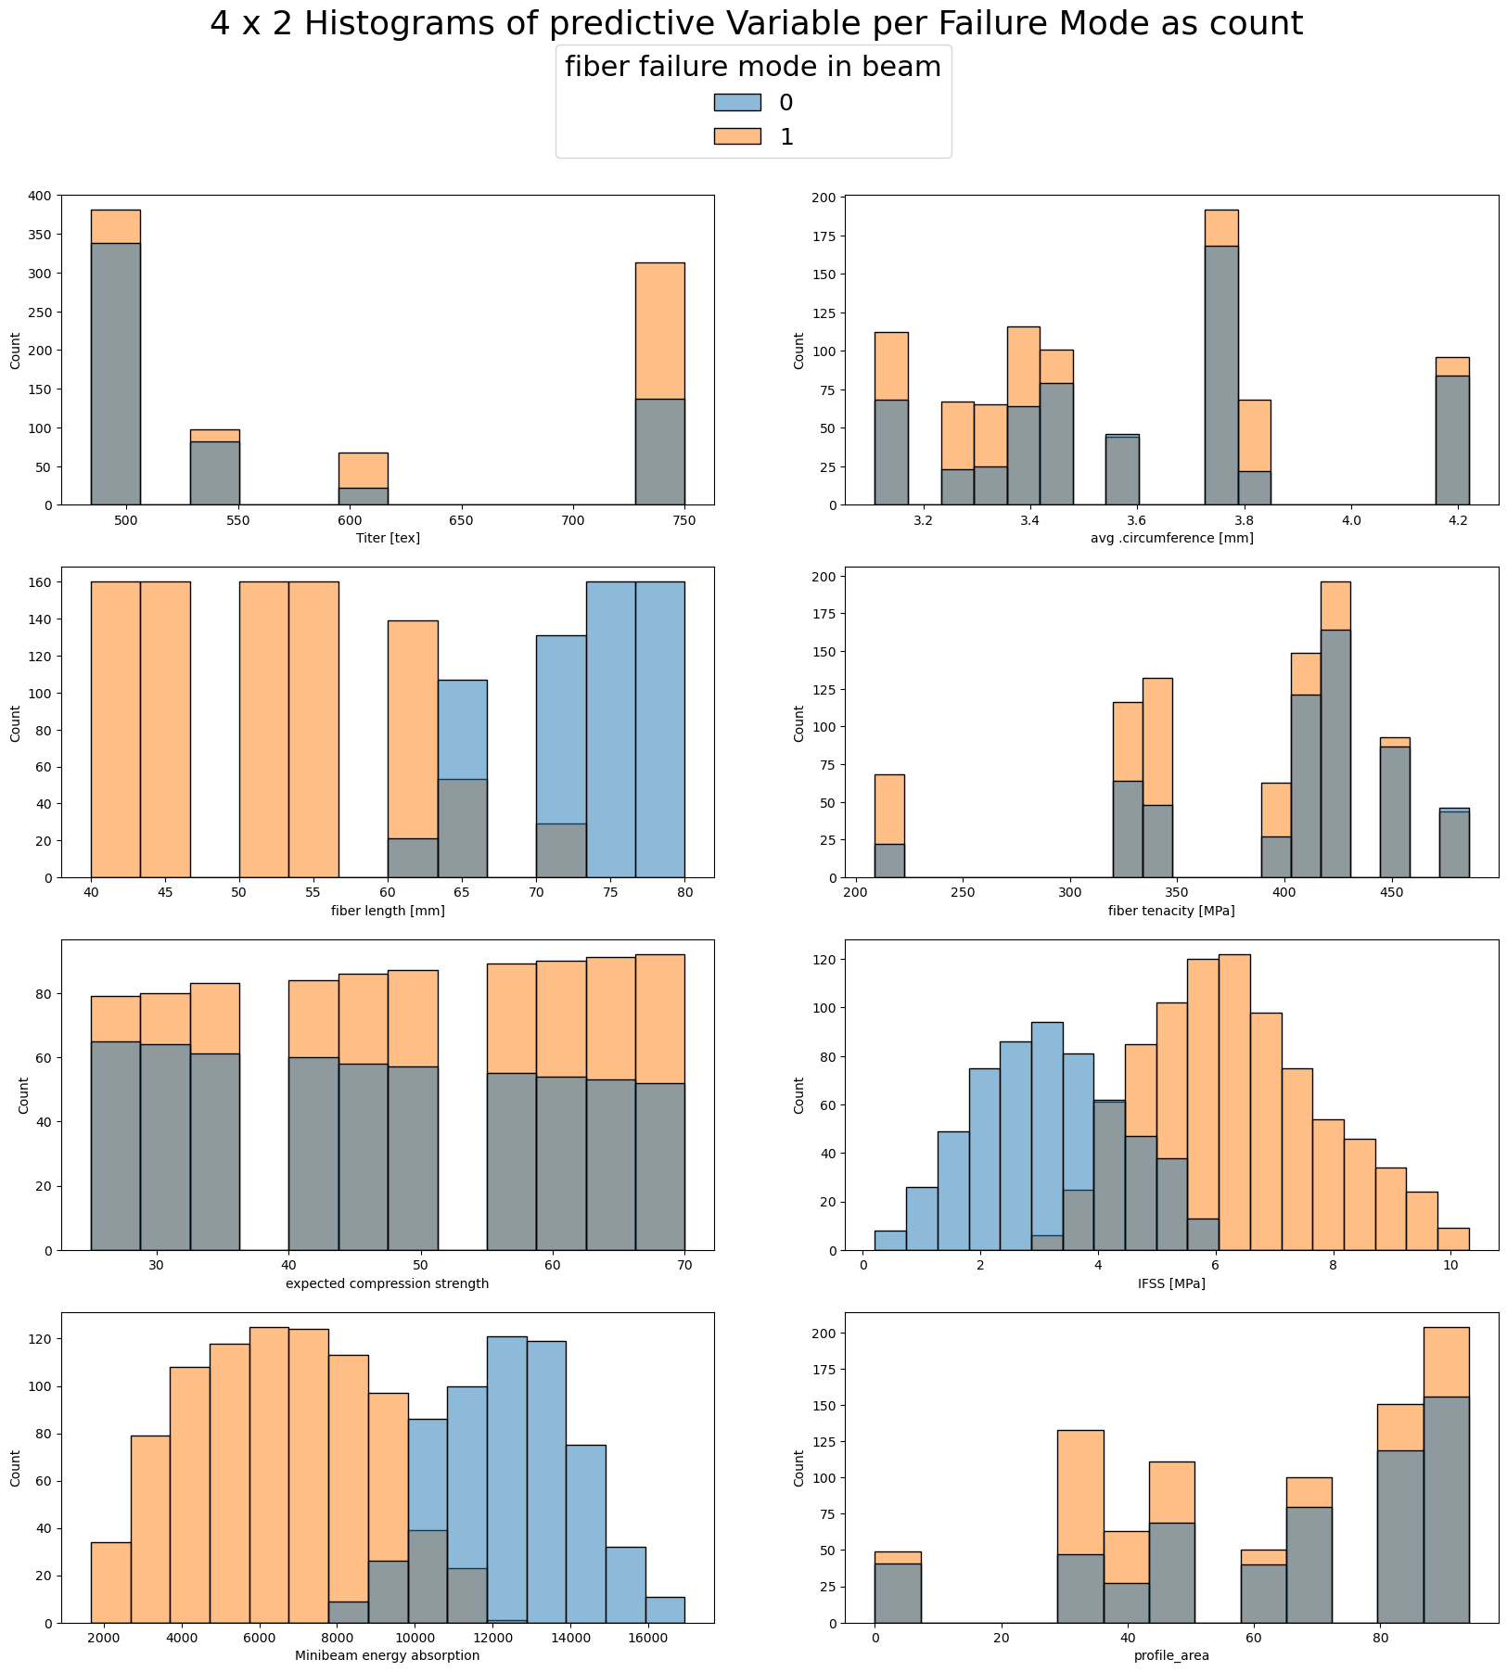
The EDA
No significant outliers found with z-scores > 3 or <-3
Some significant correlations found through PearsonsR
Some unexpected correlations with fibre length
Not a perfect correlation between failure mode and energy absorption

Slide 9
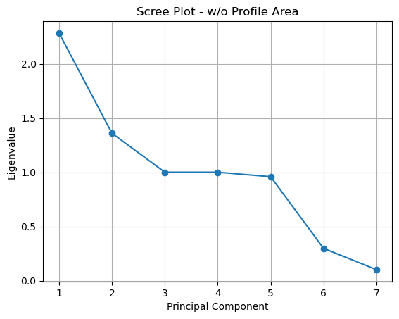
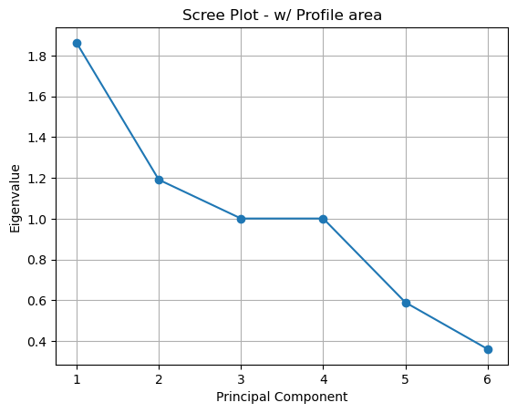
The PCA
Suggests dimensionality reduction to 4 or 5 principal components
Due to the relatively small size of the data and the ease of computing, we chose to continue to utilize the full dataset w/o Profile Area to increase prediction quality

Slide 10
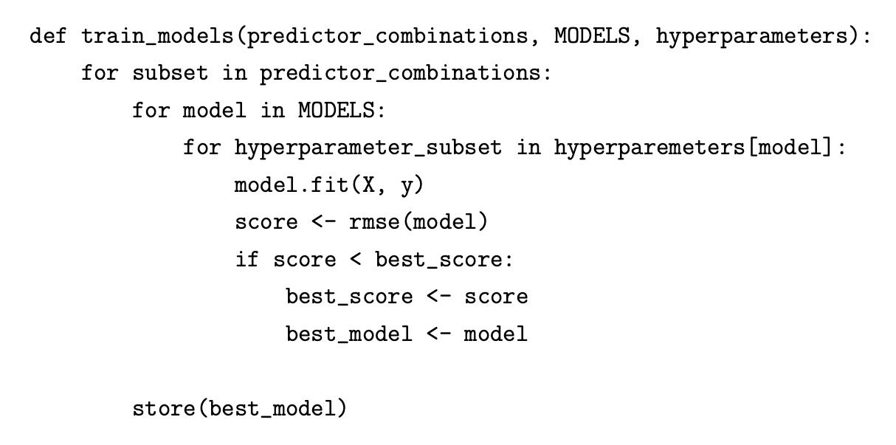
The Models
Predictions utilizing Ridge Regression, Lasso Regression, RandomForest, Gradient Boosting & SVR

Slide 11
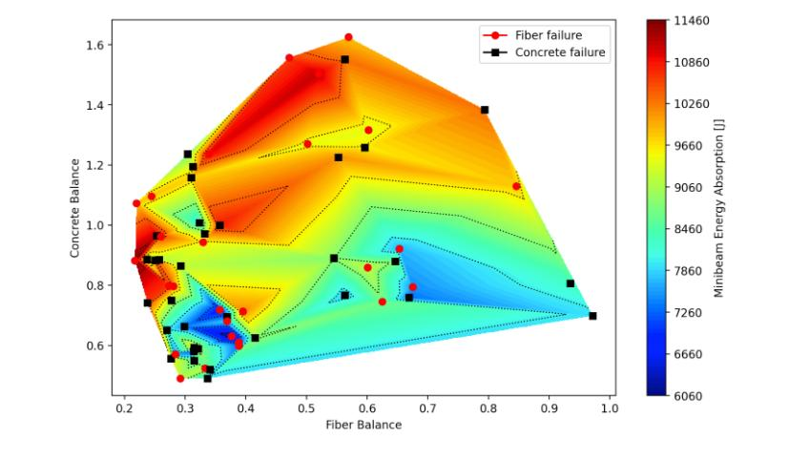

Streamlit Live-Demo

